Slide 1
MCSD Certification Toolkit
Chapter 3

Slide 2
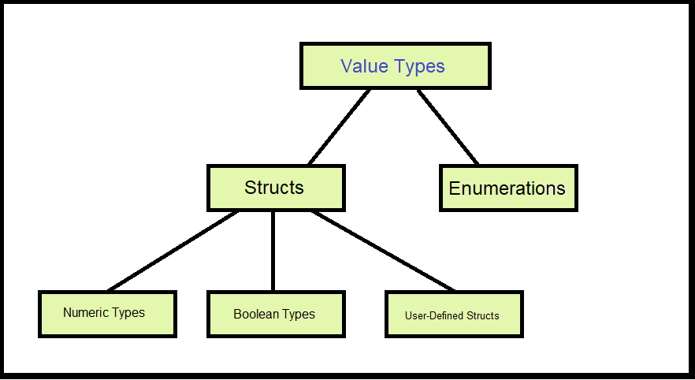
Value types in C#

Slide 3
Understanding Pre-defined Value Types
Simple intrinsic types, each type having a corresponding type in .Net
Value Type (Alias) | .Net Type
bool | System.Boolean
byte | System.Byte
char | System.Char
float | System.Single
int | System.Int32
long | System.Int64
enum | System.Enum

Slide 4
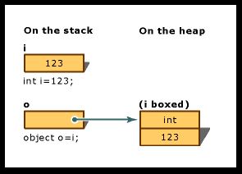
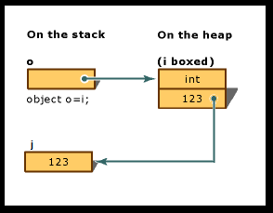
Boxing Value Types
int i = 123;
// ‘Boxing’ a value type
System.Object o = i;
// Unboxing a value type
int j = (int)o;

Slide 5

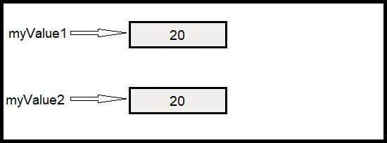
Value types in C# - Assignment of numeric type
int myValue1 = 20;
int myValue2 = myValue1;

Slide 6

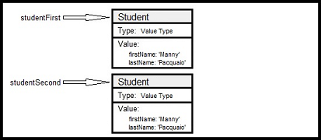
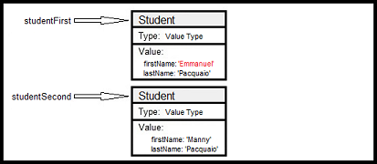
Value types in C# - Assignment of struct type
public struct Student
{
public Student(string p_firstName, string p_lastName)
{
firstName = p_firstName;
lastName = p_lastName;
}
public string firstName;
public string lastName;
}
Student studentFirst = new Student(“Manny”, “Pacquiao”);
Student studentSecond = studentFirst;
studentFirst.firstName = “Emmanuel”;

Slide 7

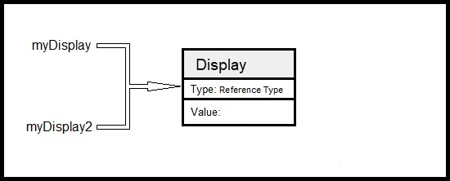
Reference types in C#
Display myDisplay = new Display();
Display myDisplay2 = myDisplay;

Slide 8
Working with Enumerations
Enumeration – A distinct type that consists of a set of named constants called the enumerator list
Declaration
public enum Months : byte
{
January=1,
February,
March,
April,
May,
…
December
};
Usage
Months myMonth = Months.January;
Constants start at 0 and increment by 1 (default), but can be assigned values
Data type is int by default, but can be set to byte, short, int, or long (or unsigned versions of the same)
Enumerations can be modified using ‘++’ or ‘--’, but cannot be assigned an integer value

Slide 9
Creating Reference Types (classes)
public class Student
{
// Default constructor
public Student()
{
}
// Constructor
public Student(string p_firstName, string p_lastName, string p_course="Political Science")
{
firstName = p_firstName;
…
}
// public method
public void SetTestScore(int testNumber, double testScore)
{
…
}
// Visibility defaults to ‘private’ if not specified
public string firstName;
public double[] testScores = new double[10];
private double GPA;
}

Slide 10
Example – class ‘Animal’
public class Animal
{
// Default constructor
public Animal()
{
}
// public method – Visible to all
public string Speak()
{
…
}
// protected method – Visible to class method and methods in derived classes
protected string WhatAmI()
{
…
}
// private variable – Visible only to methods inside this class
private double zooPrice;
}

Slide 11
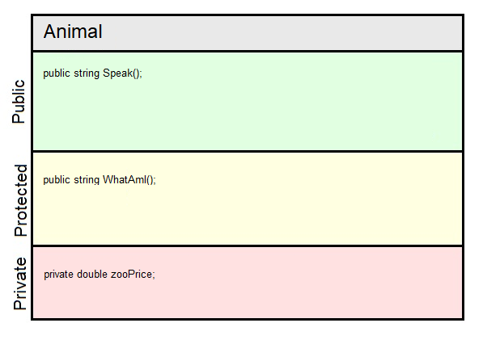
Example – class ‘Animal’

Slide 12
Animal derivation example
public class Mammal : Animal
{
}
public class Reptile : Animal
{
}
public class Amphibian : Animal
{
}
public class Tiger : Mammal
{
}
public class Human : Mammal
{
}
public class Snake : Reptile
{
}
public class Frog : Amphibian
{
}

Slide 13
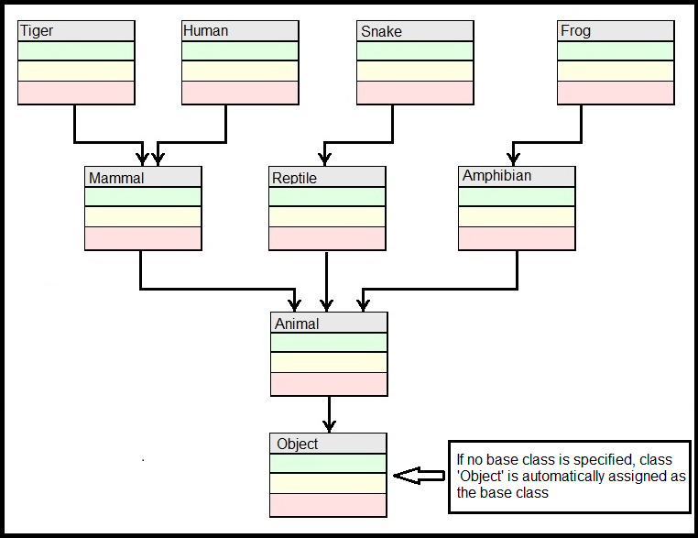
Animal derivation visualization

Slide 14
Commonly used modifiers
Modifier | Description | Type
public | Access is allowed anywhere inside or outside the class body | Access modifier
protected | Access is allowed anywhere inside the class body or inside a derived class body. Access is NOT allowed outside the class or derived class. | Access modifier
private | Access is allowed anywhere inside the class body only. Access is NOT allowed inside a derived class body or outside the class or derived class. | Access modifier
abstract | class: Class cannot be instantiated directly; method: Method must be defined in derived class; | Modifies class or method
virtual | Indicates that class functionality may be overriden in derived class | Modifies method
override | Indicates that method overrides base class definition | Modifies method
readonly | Indicates that member variable can be given a value when it is declared or in the class constructor. Once the class constructor has executed, its value cannot be changed. | Modifies member variable
static | Indicates that method or member variable is associated with the class, and not a single class instance. Reference is made my giving the class name, followed by a ‘.', and then the static variable or method name, i.e. Student.studentCount | Modifies class or method

Slide 15
Defining constructors
public class Student
{
public string firstName;
public string lastName;
public string course;
// Default constructor
// C# will implement one if none is provided
public Student()
{
}
// Notice that there is no return type
public Student(string p_firstName, string p_lastName, string p_course="Political Science")
{
firstName = p_firstName;
lastName = p_lastName;
course = p_course;
}
}

Slide 16
Defining constructors, continued
public class HighSchoolStudent : Student
{
// Calling base class constructor from derived class
public HighSchoolStudent(string p_firstName, string p_lastName, string p_course, bool p_IsCheerLeader)
: base(p_firstName, p_lastName, p_course) // Call base class constructor
{
IsCheerLeader = p_IsCheerLeader;
}
bool IsCheerLeader;
}

Slide 17
Defining Methods
[Access Modifier] [Method Modifier] <Return Type> <Method Name> ([Method Parameters])
{
[Body of Method]
}
public abstract class Student
{
public double GetAverageScores()
{
…
}
// Method override, same name, different parameters (different ‘signature’)
public double GetAverageScores(double[] Scores)
{
…
}
// Method can be overridden in derived class
public virtual double GetGPA()
{
…
}
// Abstract method has no implementation and must be overridden in derived class
// Only an abstract class can contain abstract methods
public abstract string GetAdvisorName();
}

Slide 18
Defining Methods, continued
public class HighSchoolStudent : Student
{
public HighSchoolStudent(string firstName, string lastName, double GPA, bool isOnTrackTeam)
: base(firstName, lastName, GPA)
{
IsOnTrackTeam = isOnTrackTeam;
}
// Implements required method ‘ShowDetails’
public override void ShowDetails()
{
...
}
}
public class CollegeStudent : Student
{
// Implements required method ‘ShowDetails’
public override void ShowDetails()
{
...
}
// Implements optional override ‘SayHello’
public override void SayHello()
{
...
}
}

Slide 19
Methods – Optional Parameters
public class Person
{
public void SaySomething(string Name, string Greeting=“Hello”)
{
MessageBox.Show(Greeting + “ “ + Name);
}
}
Person person1 = new Person();
person1.SaySomething(“Henry”); // “Hello Henry”
person1.SaySomething(“Catriona”, “Kumusta”); // “Kumusta Catriona”
NOTE: Optional parameters are always last

